Slide 1
Housing Data Predictions Linear Regression and KNN
Bilal Ullah

Slide 2
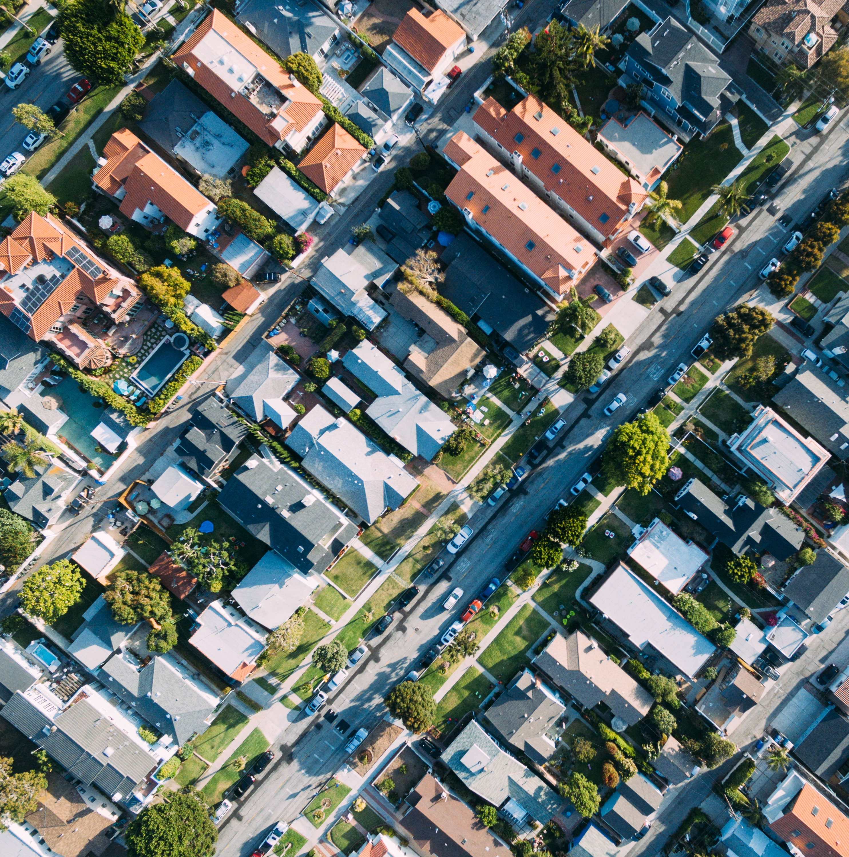
Use Case
Property developers in Arizona are having trouble evaluating house prices
I have been tasked by investors to accurately predict house prices so they can determine whether they should invest in that area or not

Slide 3
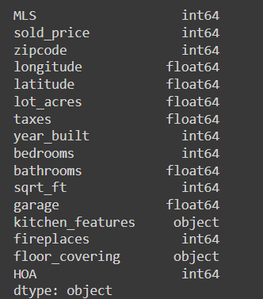
Dataset
Quick look at the features provided with the dataset
Decision to be made on what is useful to the KNN and Regression models

Slide 4
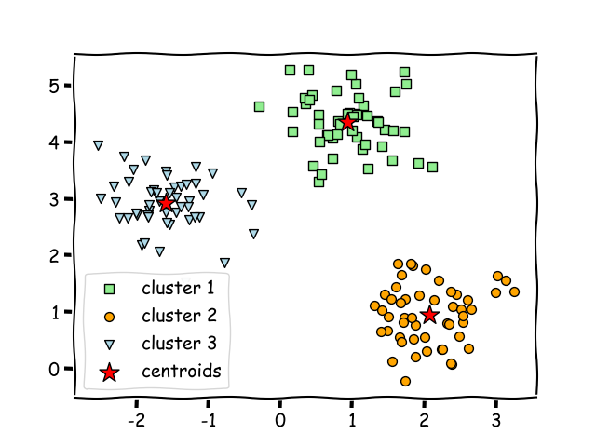
KNN Classification
Model Reasoning:
Dealing with locations
Best to split location data into categories to deal with continuous values of longitude and latitude
This grouping will allow for higher accuracy when combined with a regression model

Slide 5
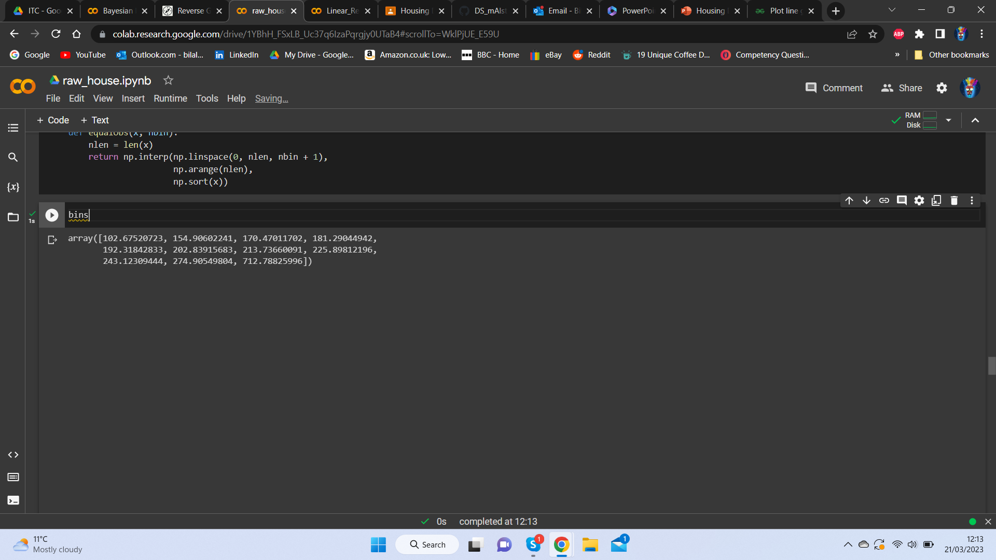
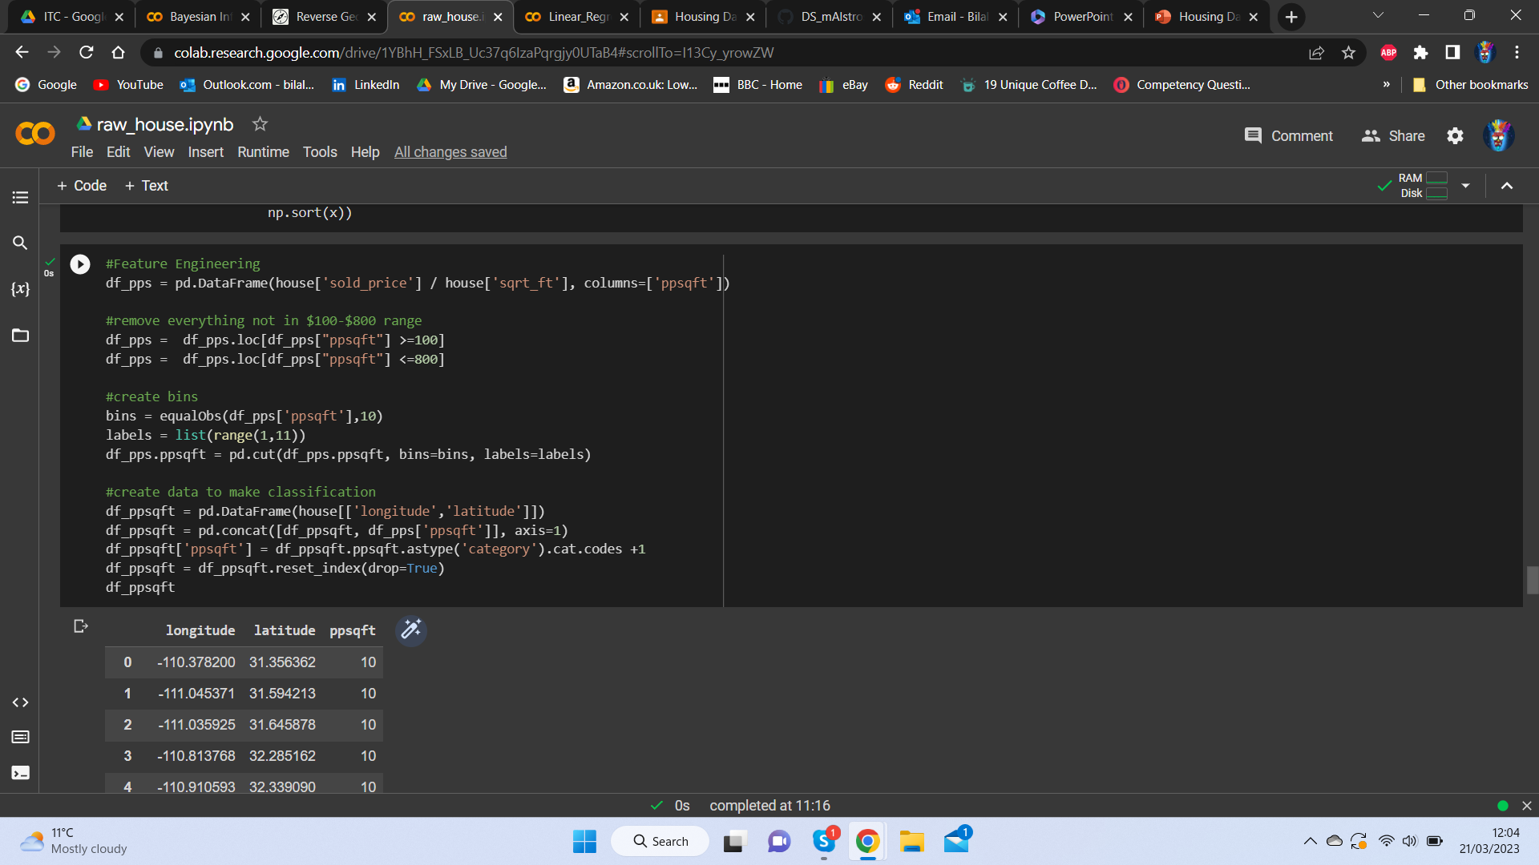
Creating bins
Bin Selection:
Creating bins based on number of values

Slide 6
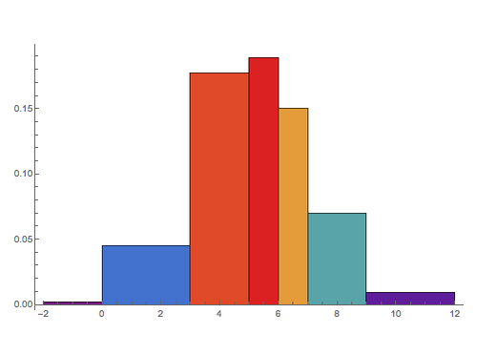
Bin Values
I decided to go with n(obv) over equal bin lengths as the clustering would be more closely related to the location

Slide 7
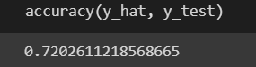
KNN Classifier Results
72% of the results were accurate
Important to not there are 10 bins were many could have been only 1 bin off

Slide 8
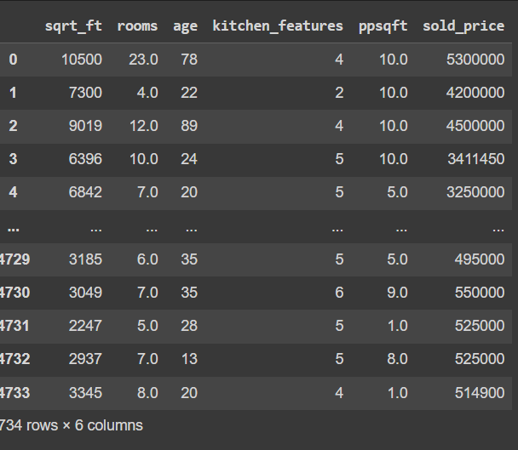
Feature Selection & Regression model
Features selected based on relationship to use case and correlation

Slide 9
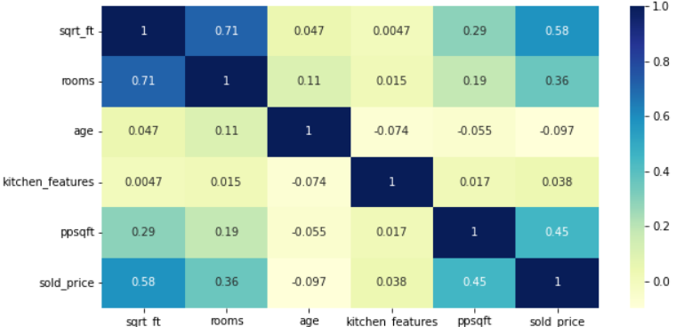

Slide 10
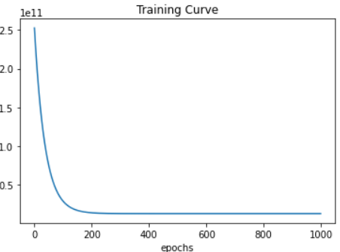
MultiVariate Regression
The learning curve shows epochs on the x-axis and learning or improvement on the y-axis
We ca see the gradual improvement and as the curve tends towards 0

Slide 11
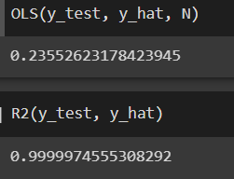
Model Results
Evaluation indicate positive results from the model
And error in regression seems to be low from looking at the OLS
And the R2 shows the data is very strongly related to the results

Slide 12
Summary
Model is able to successfully classify into bins based on sqft and price sold using KNN
These predictions are then applied in the MV Regression
Feature selection
Trained --> Tested
Positive Results
Now the model can be applied for the investors and their use case, accurate predictions of price should be able to be made now based on a few features
LIVE DEMO!!

